Slide 1

ONLINE BOOK REVIEW SYSTEM

Slide 2
GROUP NO : 03 TEAM LEADER : KUMAR AKSHANSH TEAM MEMBERS : 1) IFFAT PERWEEN – 2575711 2) INAVARAPU PRAVALLIKA – 2576100 3) INDRAVATH SAI KUMAR NAIK – 2576077 4) KALLEPALLI SRINU – 2576308 5) KIRANKUMAR D NATIKAR – 2576955 6) KONDRU PRAVEEN – 2576705 7) KUMAR MAYUR - 2577154

Slide 3
ABSTRACT :
Problem: Buying a new book c a n be disappointing if it doesn' t meet your expectations.
Solution: A Book Review system helps with this by:
Allowing the admin to add, delete, and edit books.
Keeping track of user reviews and ratings.
Providing user registration and login.
Users c a n check reviews and ratings of books.
Users can also give their own reviews and ratings for books.

Slide 4
INTRODUCTION
The “ ENZ BOOK CLUB” objective is t o design Book Review
system, and t o develop a c u s t o m e r web- based Review system.
Features:
Users c an provide ratings and r ev i ew s based on their experiences.
Book review s validate a book' w o r t h and identify i t s audience.
Peer r ev i ew s encourage others t o read t h e s am e book.

Slide 5
OBJECTIVE :
This s y s t e m objective is to design Book Review system, and t o develop a c u s t o m e r web- based Review system.
Readers c a n give ratings and reviews.
Admin can identify reader interests and publish requested books.
Saves t ime, provides insights, and fosters reader- book connections.

Slide 6
TECHNOLOGY USED :
Spring boot
Type Script
Java
My SQL
Angular
HTML
CSS
JPA
Postman

Slide 7

TOOLS USED
Server – Apache T o m c a t 9
Database – My SQL
My SQL Connector
Node JS Version 18 . 17 . 1
Postman
Angular Version 16 . 2 . 1
J D K
Eclipse IDE or Spring Tool
Suite

Slide 8
WHAT IS SPRING BOOT?
Spring Boot is a tool that makes developing web application and microservices with Spring Framework faster and easier.
Benefits of Spring Boot:
Ideal for Java developers.
Enables stand-alone and production-ready Spring apps.
Minimal configuration required.
No need for a complex Spring setup

Slide 9
WHAT IS ANGULAR?
Angular is an open-source, JavaScript framework written in TypeScript. Its primary purpose is to develop single-page applications. As a framework, Angular has clear advantages while also providing a standard structure for developers to work with.
Angular Overview:
Platform and framework for single-page client apps.
Uses HTML and TypeScript.
Core functionality in TypeScript libraries.
Relies on Angular components within NgModules for
application architecture.

Slide 10
WHY DO WE NEED A FRAMEWORK?
Benefits of Frameworks:
Enhance web development efficiency and performance.
Provide a consistent code structure.
Save time by offering extra features without extra coding
effort.

Slide 11
HTML & CSS
HTML: Defines page structure.
CSS: is used to style an HTML document and describes how
HTML elements should be displayed.
Together with graphics and scripting, they form the basis of web development.
HTML for page structure, CSS for presentation including colors, layout, and fonts.

Slide 12
MYSQL
Popular open-source database management system.
Supported by Oracle.
Known for speed, scalability, and user-friendliness.
Utilizes Client-Server Architecture for user access through a
central server.

Slide 13
POSTMAN
Comprehensive API development platform.
Supports the entire API lifecycle.
An API client for creating, sharing, testing, and documenting
APIs.
Features a user-friendly and powerful toolset.
Available on MacOS, Linux, and Windows through native
apps.

Slide 14
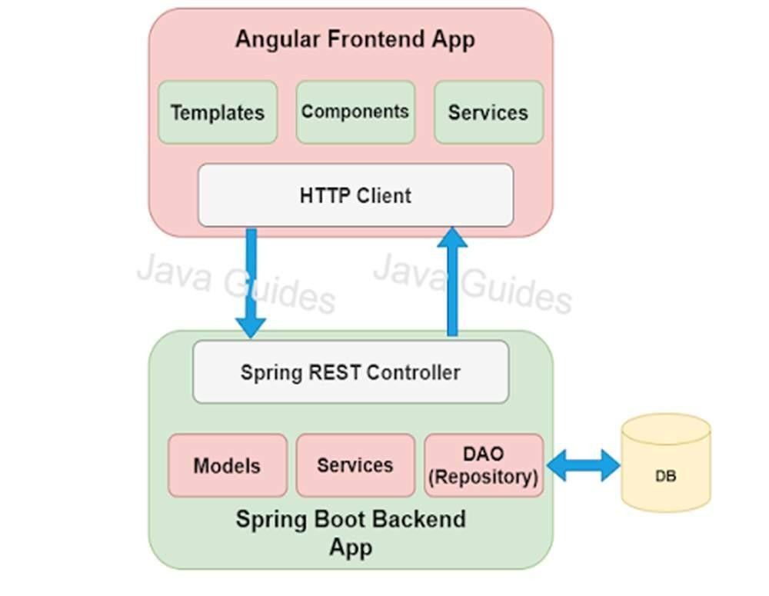
PROJECT ARCHITECTURE

Slide 15
MODULES
The system comprises of 2 major modules with their sub-modules as follows:
1. Admin :
Lander Page : Main page and has 2 buttons for admin login and User login
Admin Login: Admin can login by using username and password
Dashboard: Admin dashboard has two buttons for Booklist and Rating list d.Admin Book List : This list contains all the books with edit, enable and
delete button
e. Rating List: This list has the rating given to the books by the readers
f. Logout : This is used to logout when all work is done

Slide 16
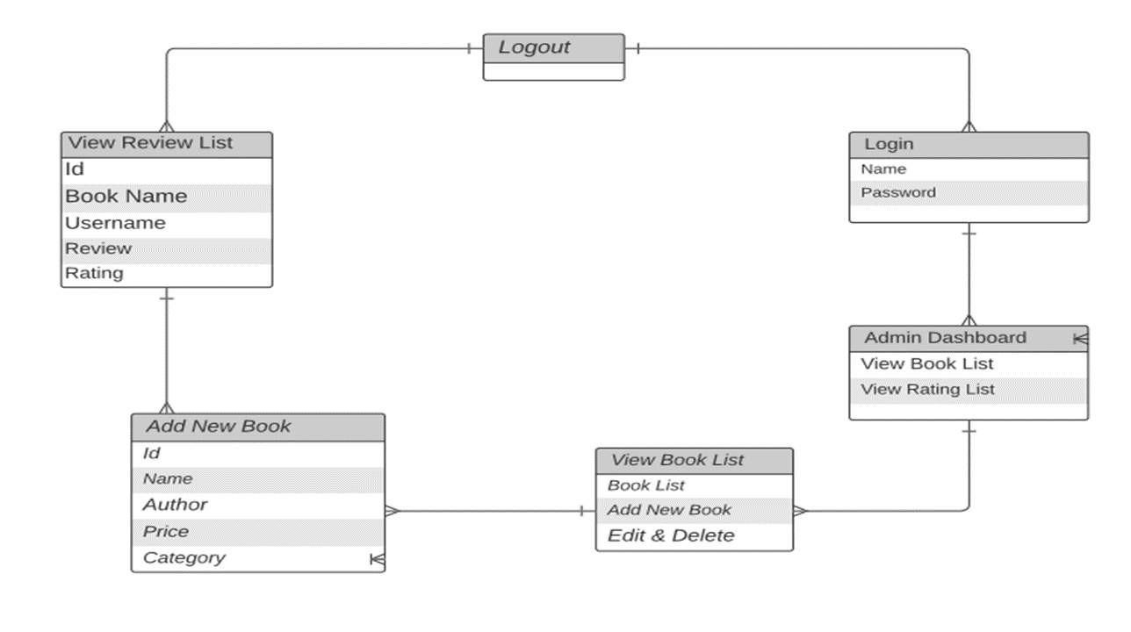
ER DIAGRAM FOR ADMIN

Slide 17
2. USER :
User Login: User can login using email-id and password
User Registration: User can register themselves
User Dashboard : User dashboard has 2 buttons for booklist and user profile
Booklist :Book list has all the books with a review button
Review : This gives details of the book and you can give rating and review
User Profile: This gives details of the user who has logged in
Update Profile: Update profile is used to update details related to user

Slide 18
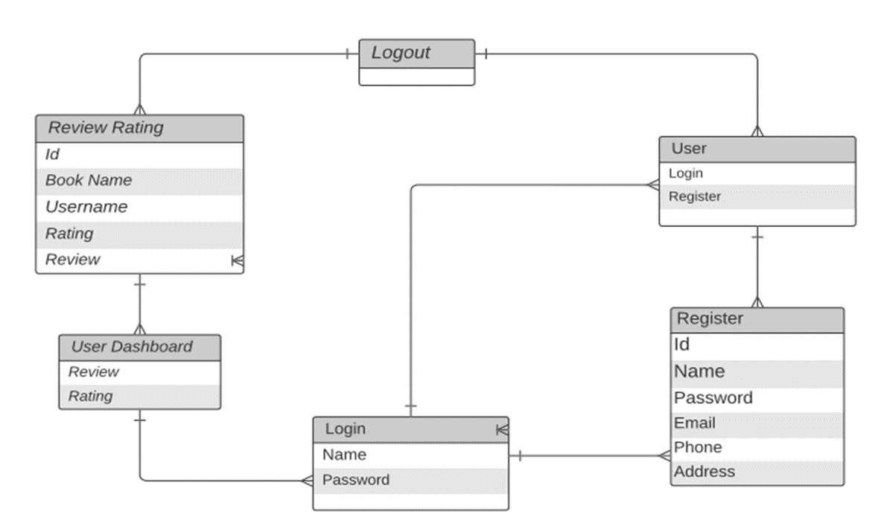
ER DIAGRAM FOR USER

Slide 19
LANDER PAGE
The Lander page is the main page.
The Lander page has 2 buttons that is admin
Admin login and user login :
Admin Login takes us to admin login page.
User Login takes us to user login page.

Slide 20
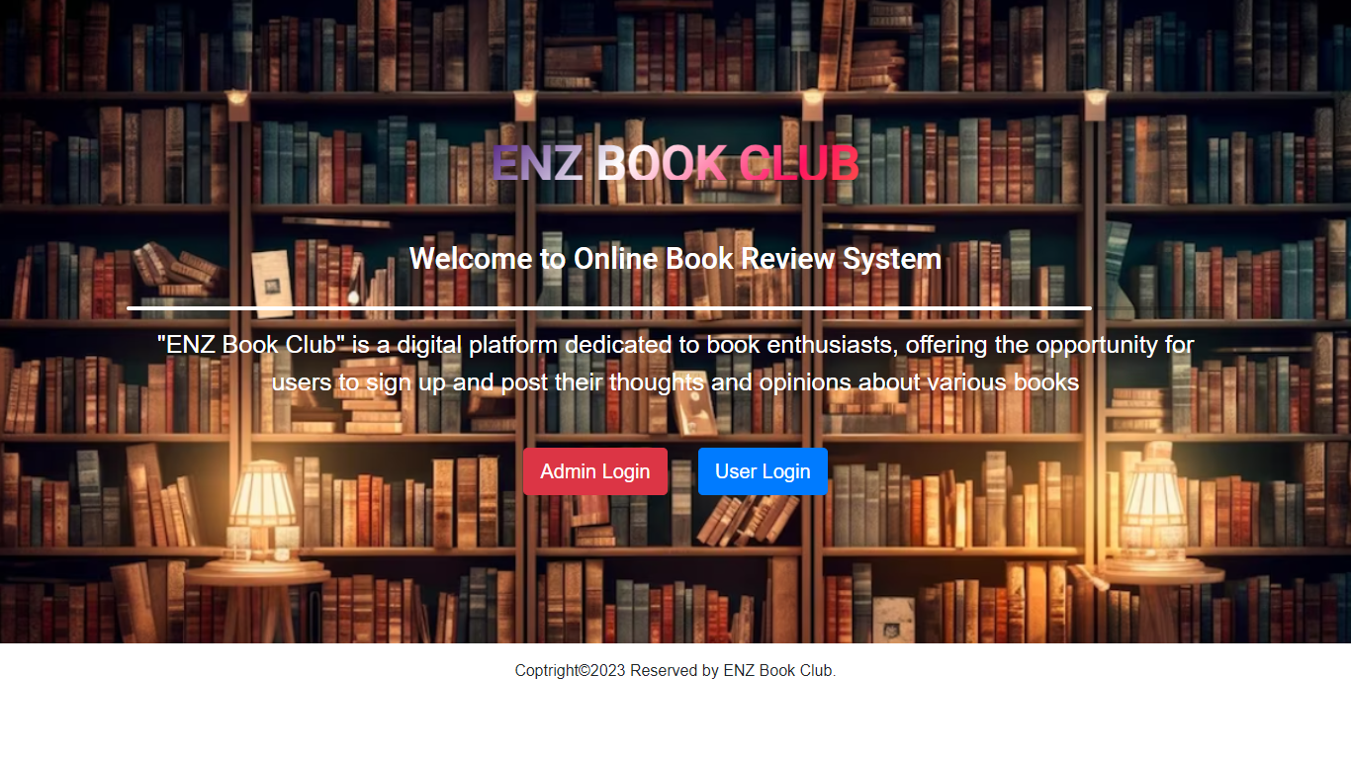

Slide 21
ADMIN LOGIN
In the admin login page the admin can login using username and password which is already saved.
If you type wrong password it will give invalid username or password.

Slide 22
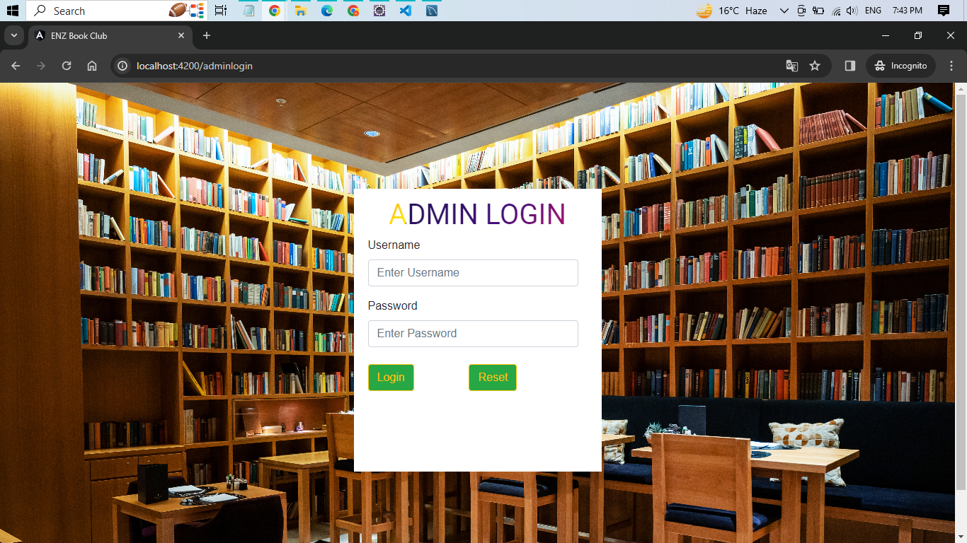

Slide 23


Slide 24
ADMIN DASHBOARD
Admin Dashboard page consist of two buttons:
Display Book list :
It will display the book list that will contain add new book, edit
,delete and disable/enable functionality.
Display Rating list :
It will display the rating and review list that contains book, user,
ratings and comments given by the user.

Slide 25
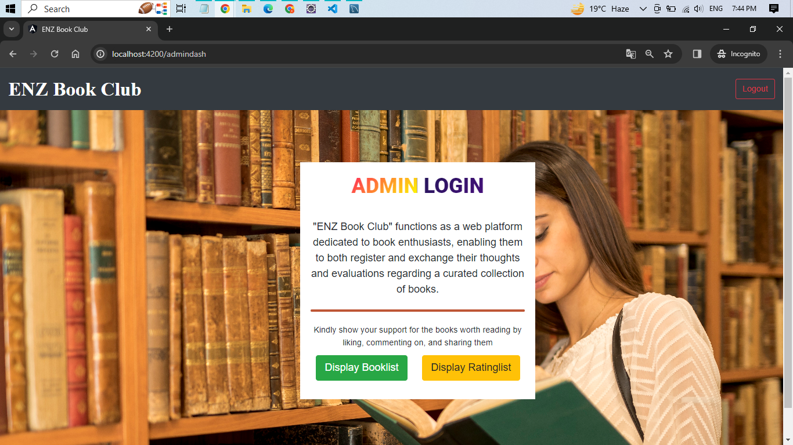

Slide 26
ADMIN ADD BOOK
Add Functionality:-
Purpose: To add the book details.
Endpoint: It is accessed through `/add/`
Process:
When we click on add new book button it navigates to admin add book page.
Admin can add author, name , price and category by clicking on add book button.
Admin can view the added book data in the list.
Importance: Adding book details functionality allow the admin to efficiently manage the book catalogue and it improves the user experience by providing a user friendly interface.

Slide 27
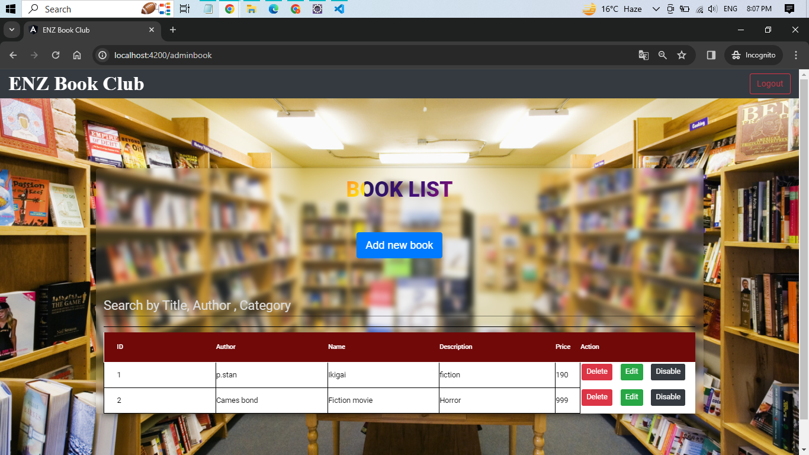

Slide 28
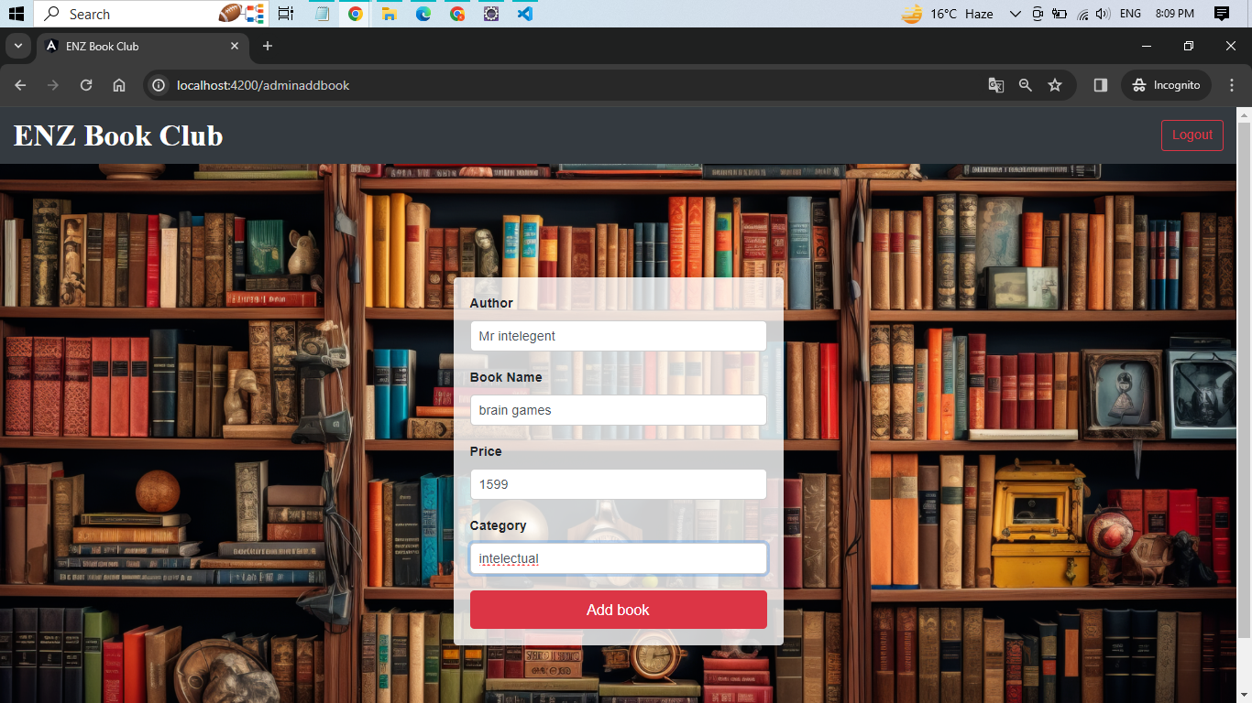

Slide 29
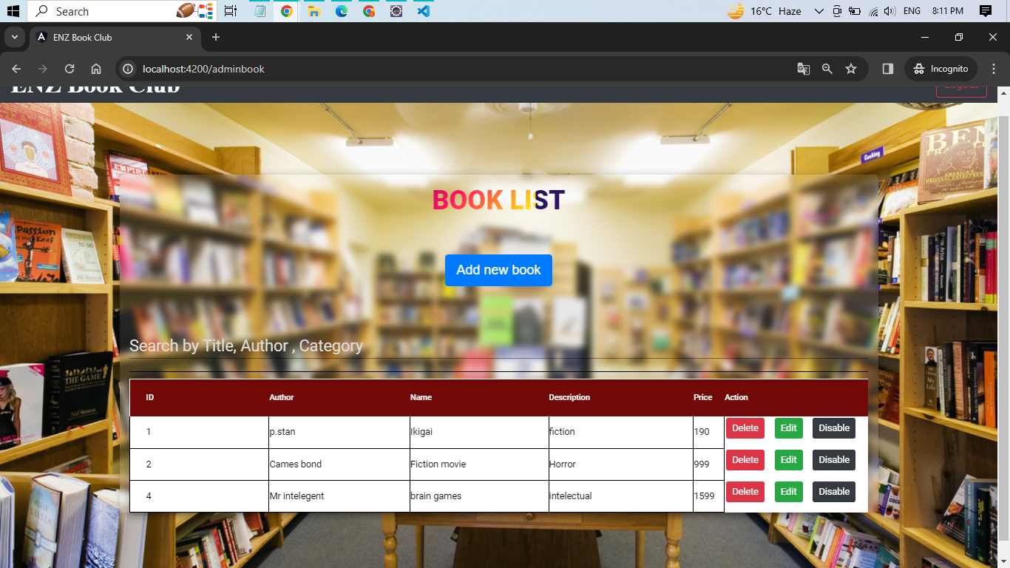

Slide 30
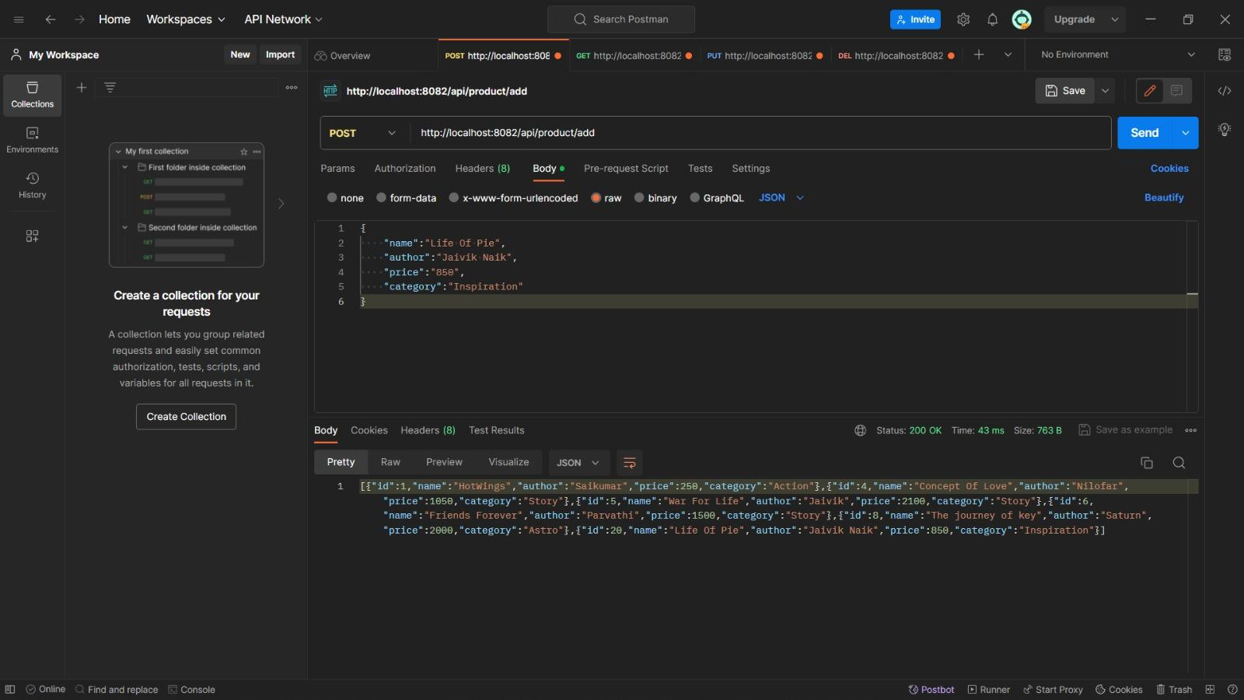

Slide 31
ADMIN DELETE BOOK
Delete Functionality:-
Purpose: To delete the book details.
Endpoint: It is accessed through `/api/product/{id}`
Process: When the delete button is pressed, a pop-up window will appear at the top, seeking confirmation for the deletion action. If the "Yes" option is chosen, it results in the removal of the specific record's data.
Importance: If the data can become outdated or irrelevant delete button allow user to remove such data. It also provides a mechanism to rectify these mistakes and maintain data accuracy.

Slide 32
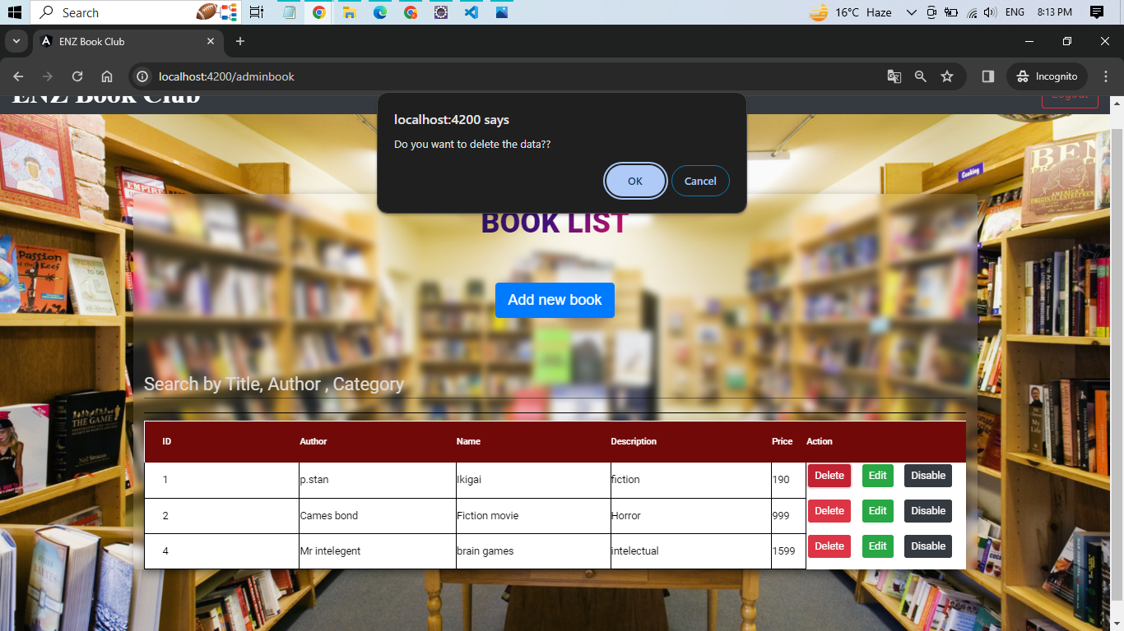

Slide 33
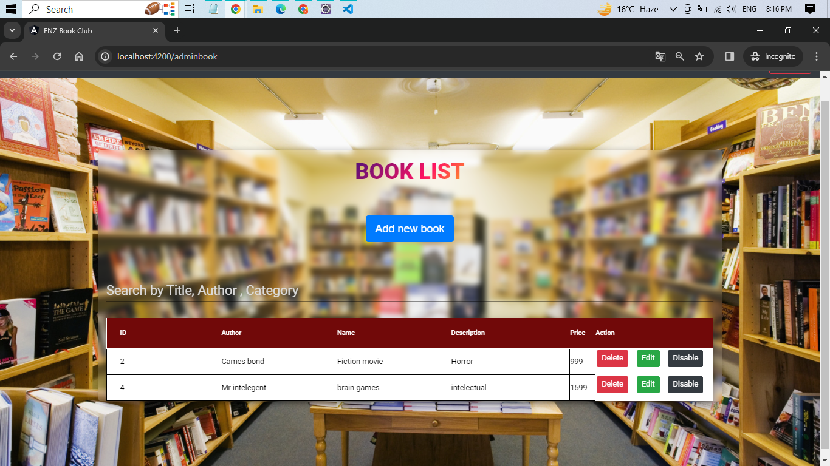

Slide 34
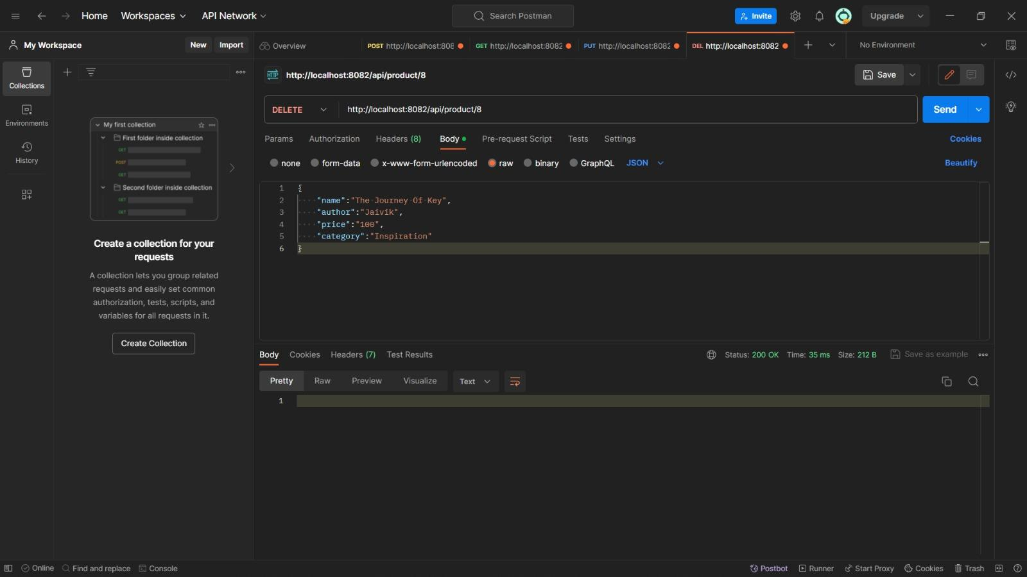

Slide 35
ADMIN EDIT & UPDATE BOOK
Edit Functionality:-
Purpose: Modify the existing book details.
Endpoint: It is accessed through `/edit/{id}`.
Process: To retrieve and change book information.
Importance: It ensures data accuracy.
Update Functionality:-
Purpose: To keep book records up to date.
Endpoint: Use `/update/{id}`.
Process: To apply changes to book data.
Importance: It is crucial for user satisfaction.

Slide 36
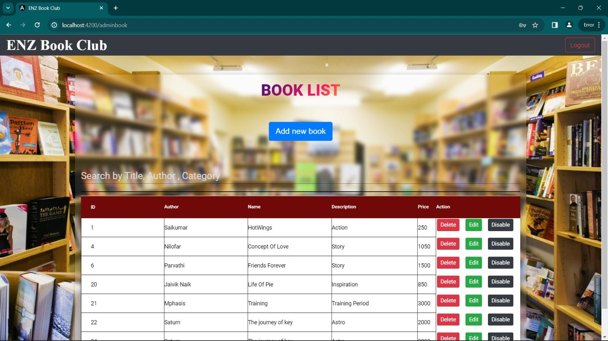

Slide 39
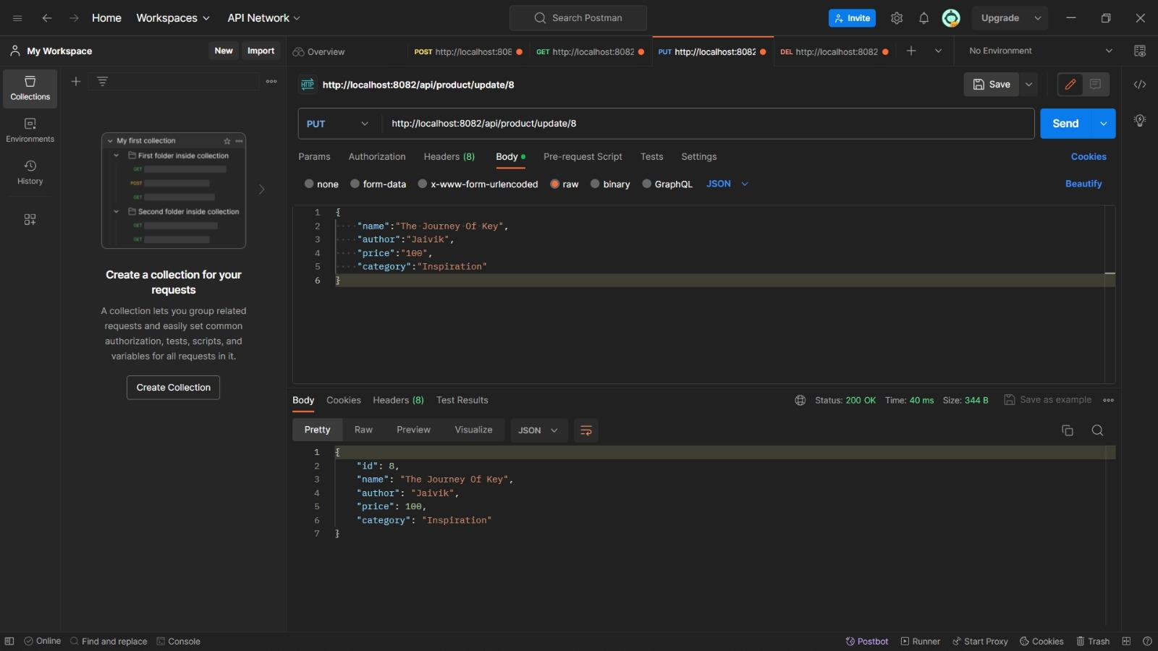

Slide 40
ENABLING & DISABLING FUNCTIONALITY
Enabling Books -
Administrators can activate book records.
Enables access and functionality associated with the
book.
Disabling Books –
Administrators can deactivate book records.
Restricts access and associated functionality.

Slide 41


Slide 42
ADMIN BOOK REVIEW LIST
After logging into the admin navigate to the admin dashboard.
Click the display rating list button.
It takes you to admin rating and review list.
The rating and review list gives you the rating
reviews of all the users.

Slide 44
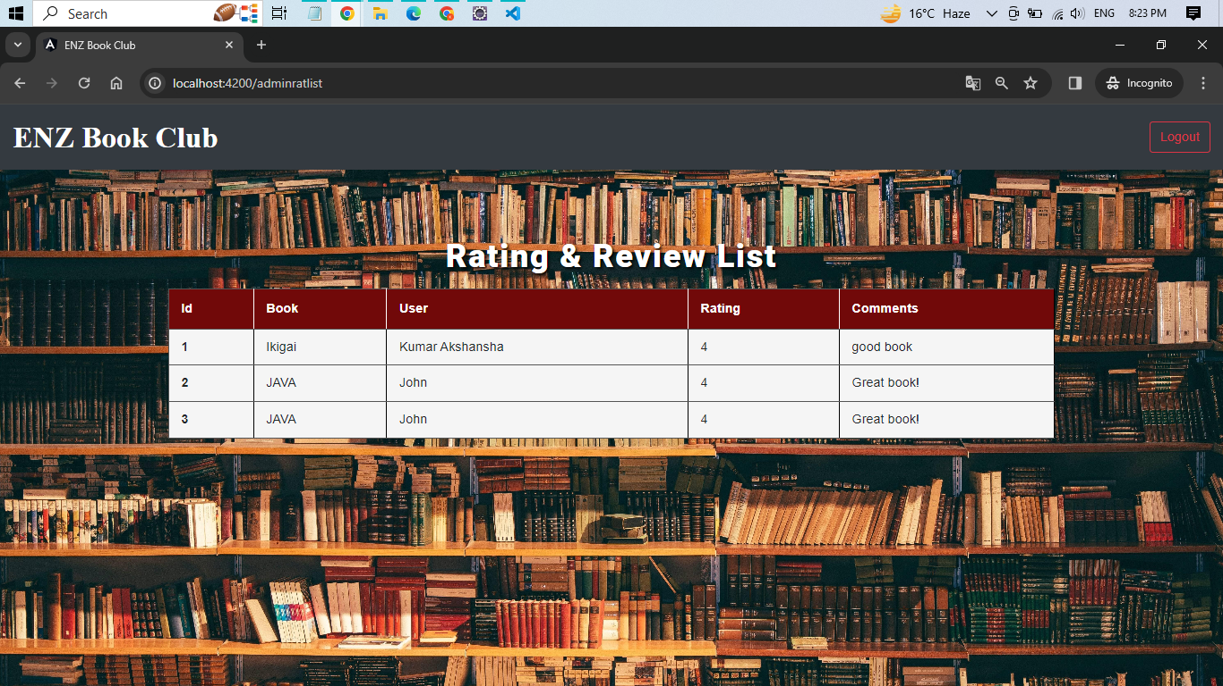

Slide 45


Slide 46
USER REGISTRATION
This web application “Online
Book
Review
System”, has
ANOTHER MAIN MODULE WHICH IS THE USER MODULE.
THIS USER REGISTRATION PAGE HAS BEEN DESIGNED USING THE ANGULAR WHICH ACTS AS A TOOL FOR FRONT END NEEDS AND HAS USED THE SPRING BOOT FOR SERVER SIDE CONNECTIVITY.
THIS INCLUDES A FORM FOR CREATING THE NEW ACCOUNT FOR THE USER WHICH PROMPT FOR THE DETAILS OF THE USER LIKE FIRST NAME, LAST NAME, EMAIL ADDRESS AND PASSWORD ,PHONE NUMBER.

Slide 47
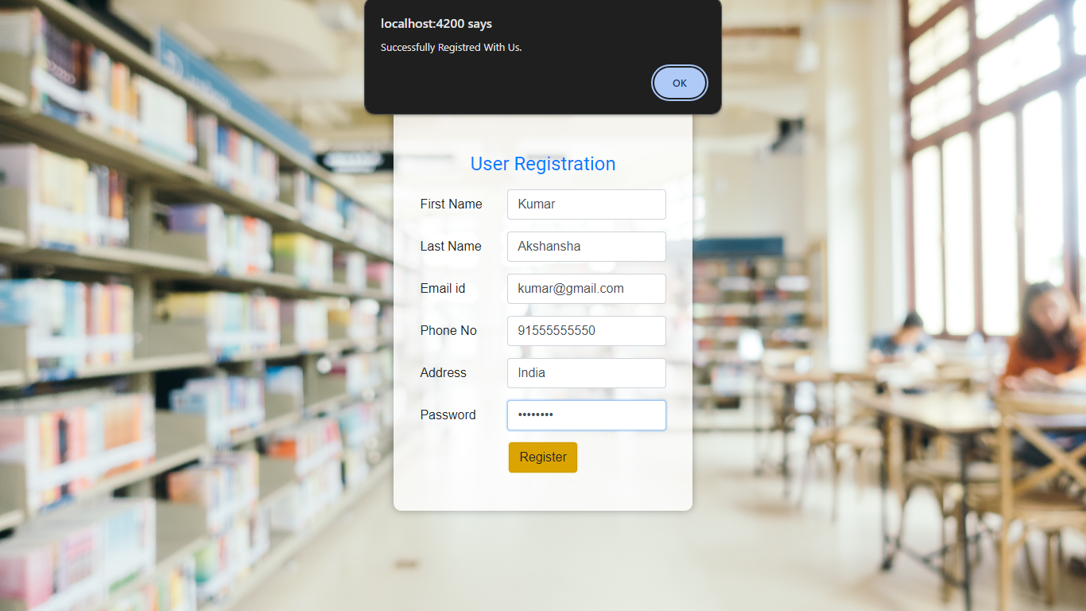

Slide 49
USER LOGIN
After the successful creation of new account, the user will be navigated to the user login page.
This user login page includes a form for entering the username and the password that is created by the user on the phase of registration and can log in to the portal.

Slide 50
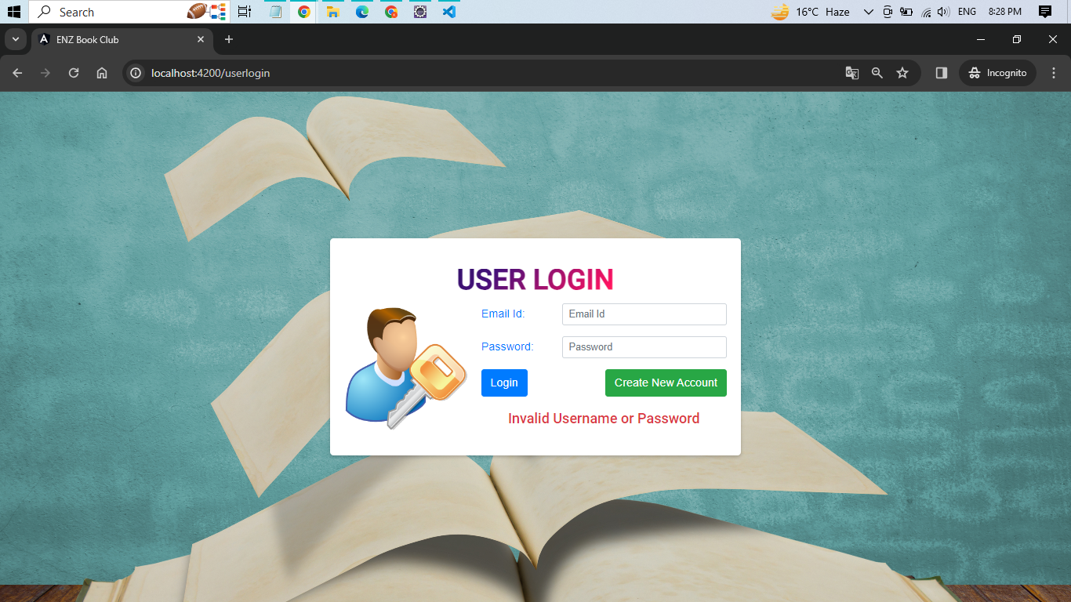

Slide 51
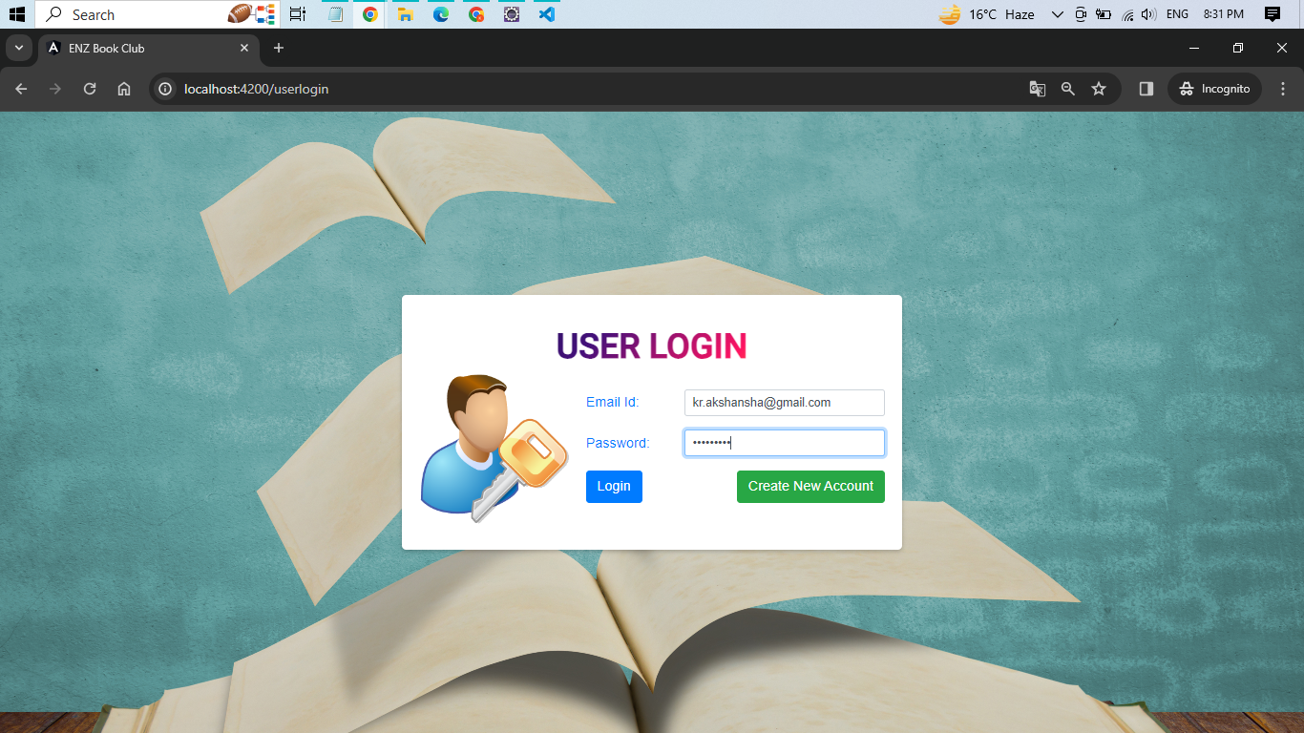

Slide 52
USER DASHBOARD & BOOKLIST
After successful login the user navigates to the user dashboard.
User can click on book list and access the book list.
The user can see the list of books with name, author, category
and price.
User can search the book by the title and author name.

Slide 53
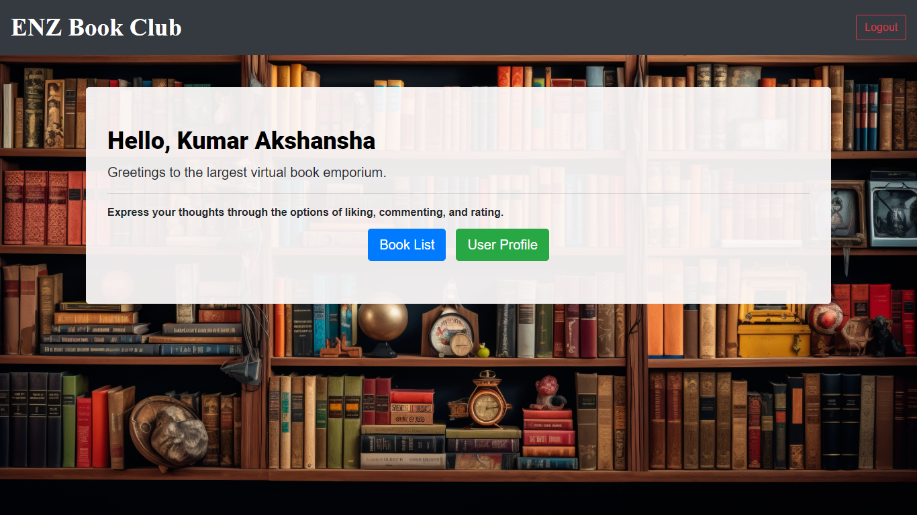

Slide 54
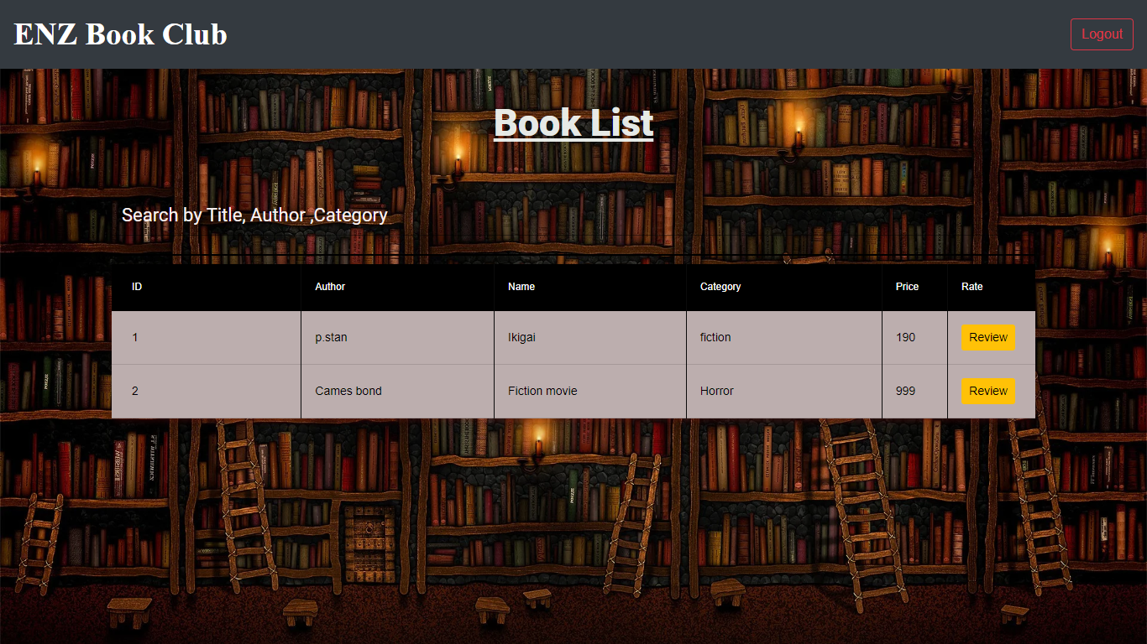

Slide 55
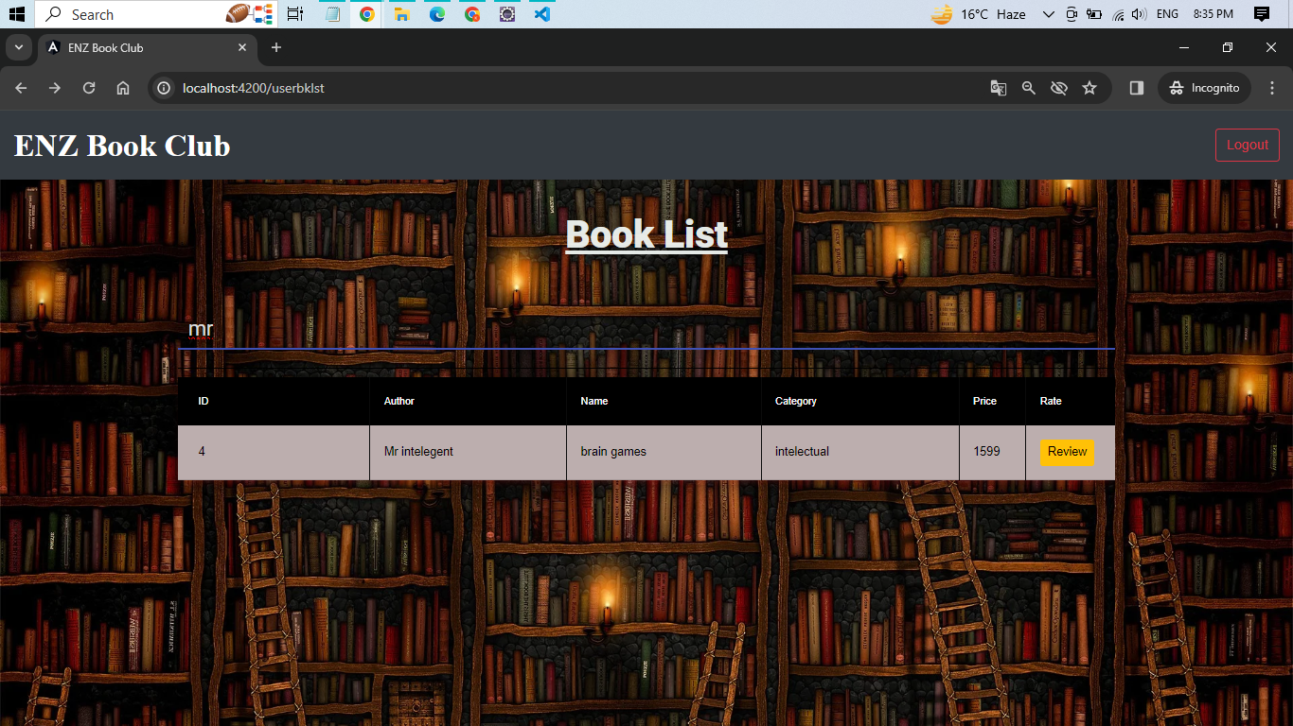
0

Slide 57
USER PROFILE
User profile shows the details of the user like name , email , phone and address.
It also has a update profile button.
The update profile button navigates to update profile page.

Slide 58
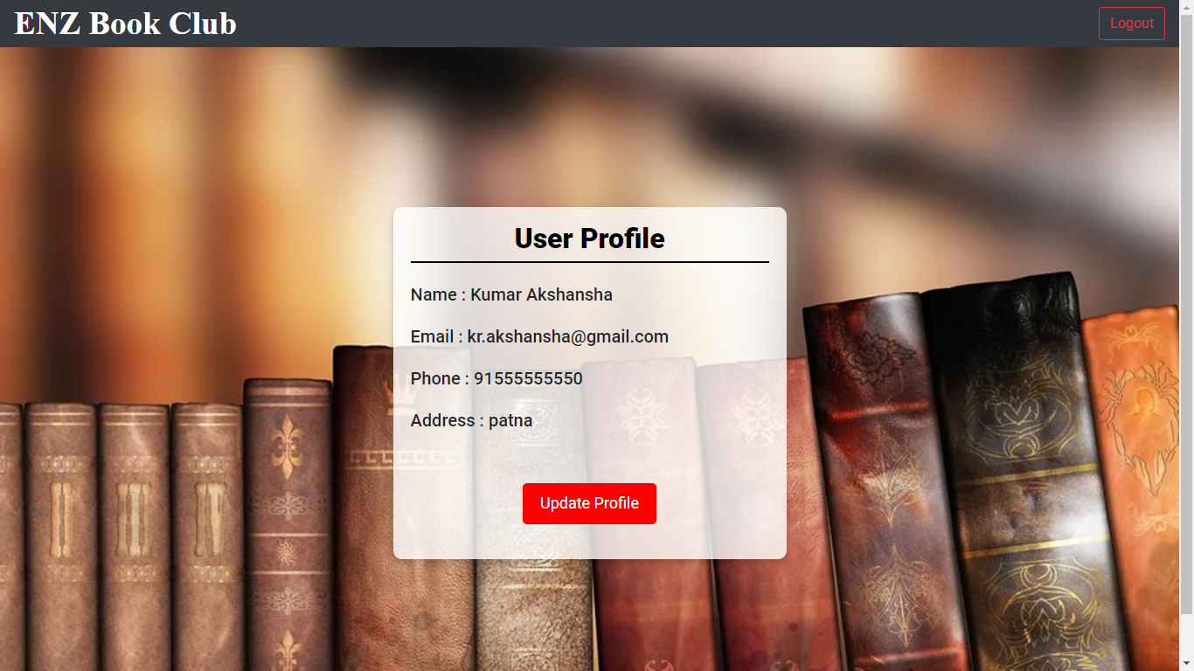

Slide 59
UPDATE PROFILE
Update profile page helps us to change the details of the user.
We can change first name , last name , phone number and address.
The user cannot change their email-id.
The user can update the password.

Slide 60
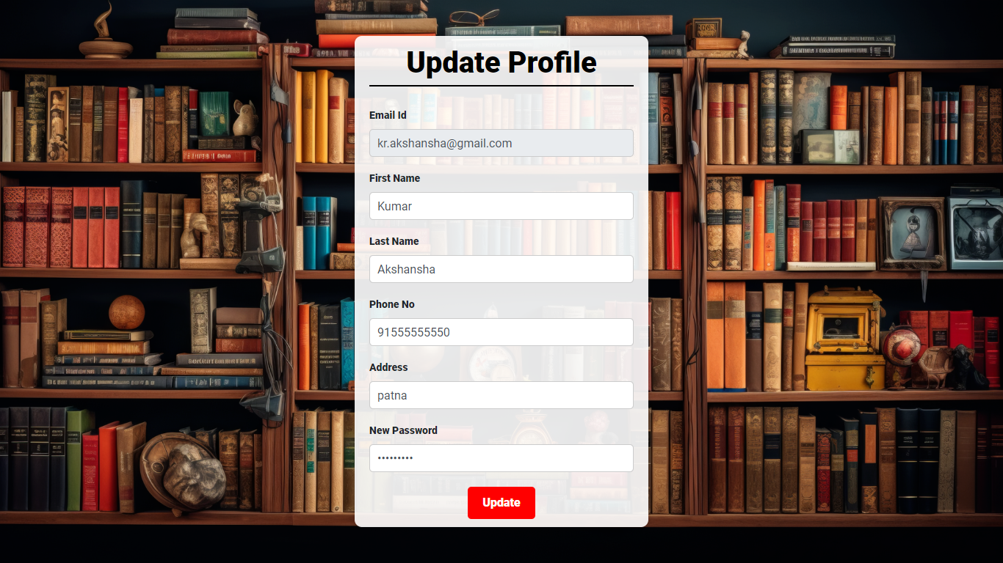

Slide 62
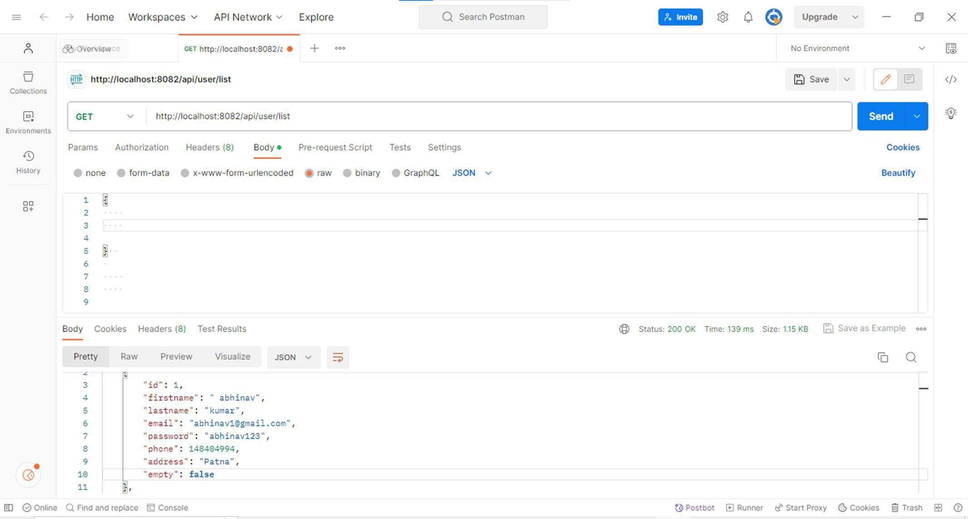

Slide 63
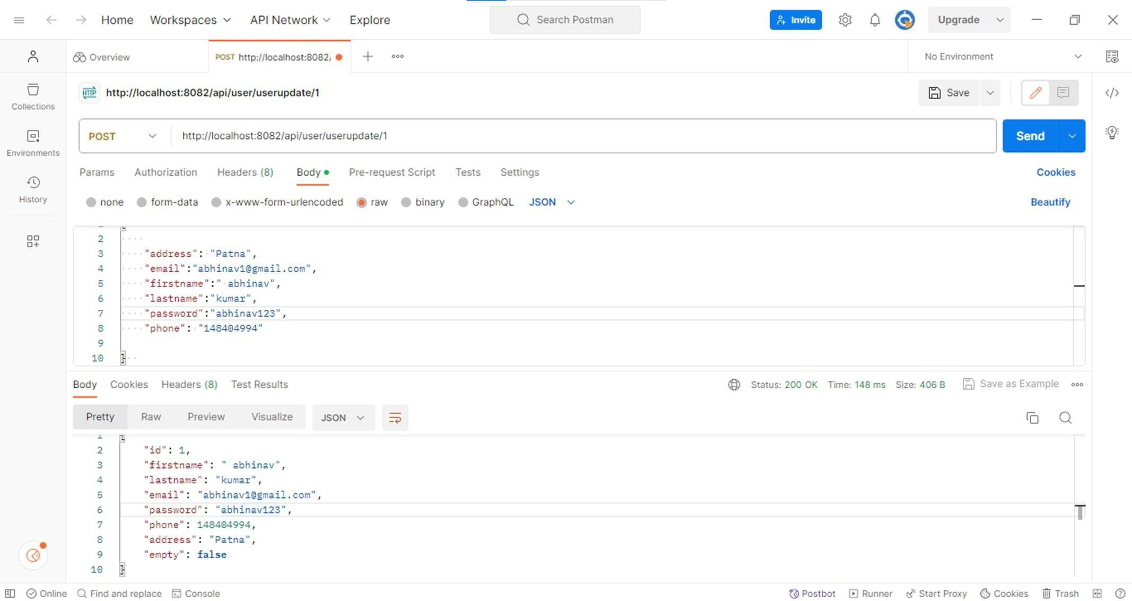

Slide 64
USER RATING & REVIEWS
This page contains the following functionalities:
It will display the container by the name of "Book details" that
will contain book name, author , price and category.
Below that it will display the another container by the name of "Give Us Star Rating" and a "Review box"
User can slide the bar to give the star rating between 1 to 5.
In the Review box one can leave comment about the book.
At last one can submit the reviews and ratings by clicking on
the "Submit Button".

Slide 66
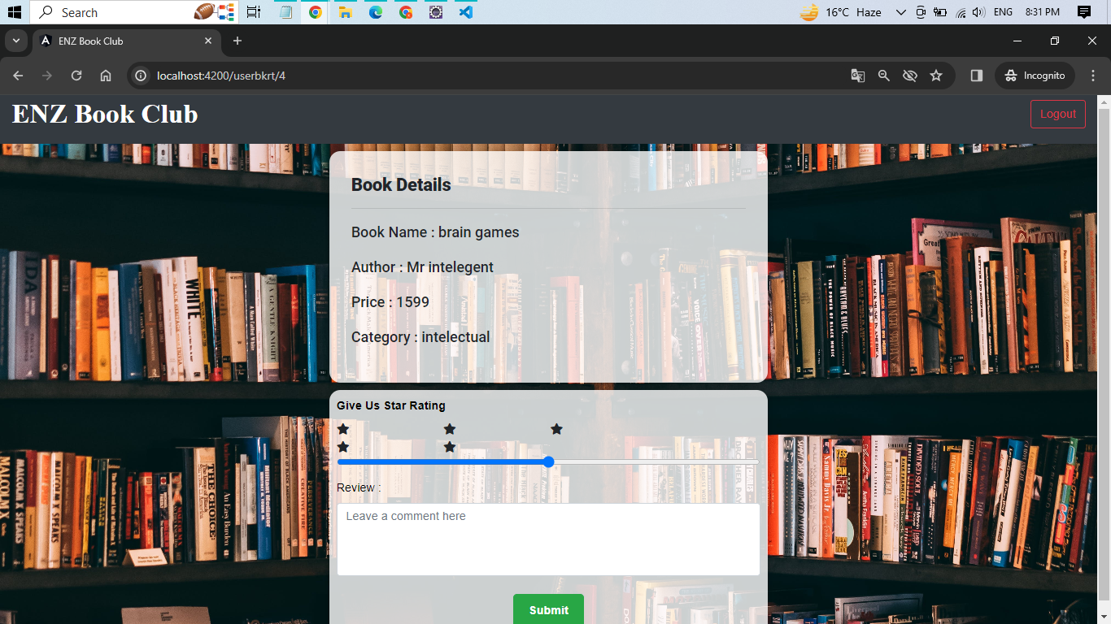

Slide 67
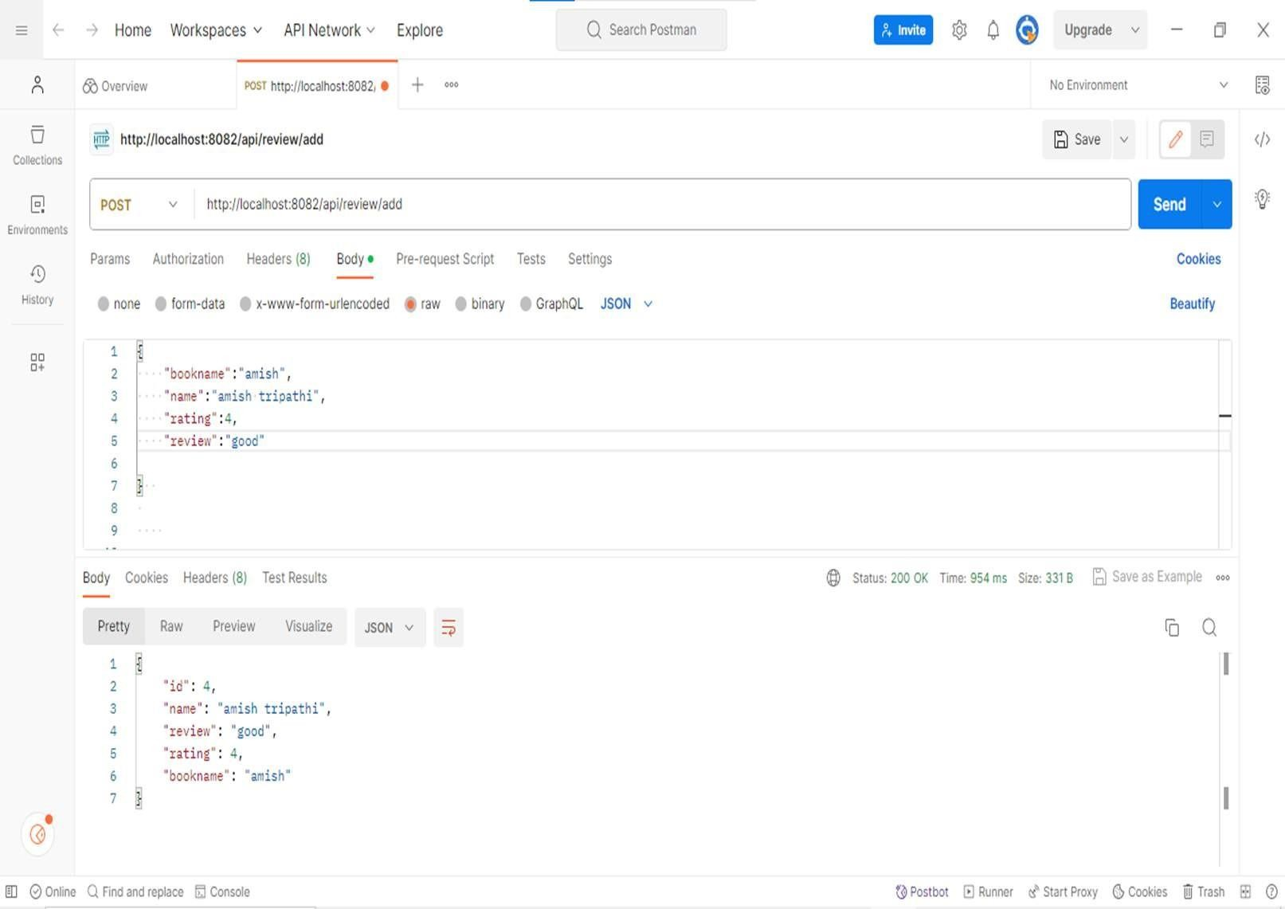

Slide 68

THANK YOU

